Slide 1
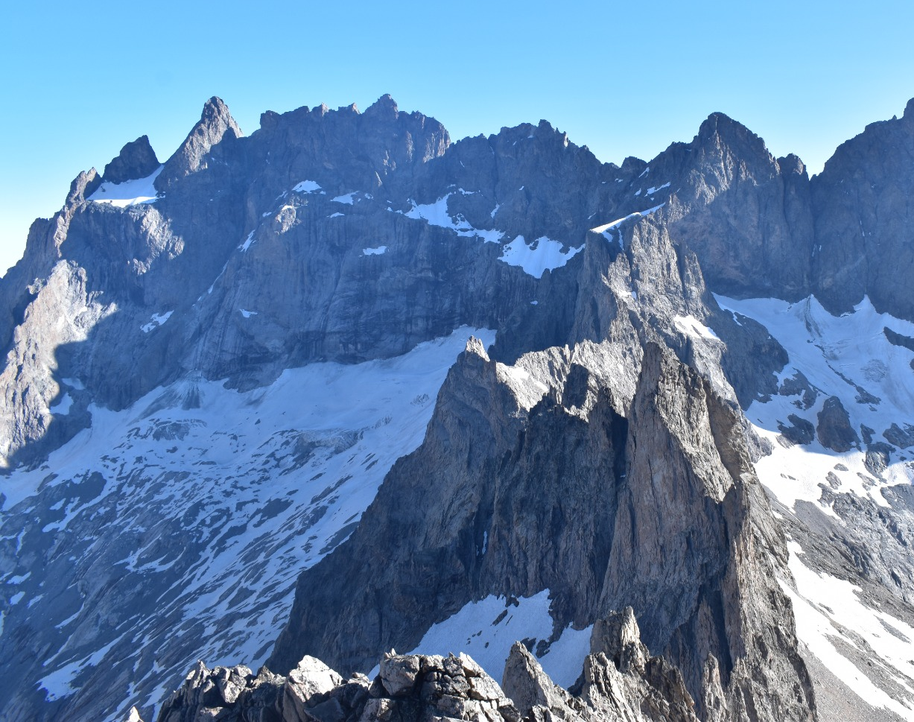
NSAC Summer Program 2022
By: Jan van den Berg

Slide 2
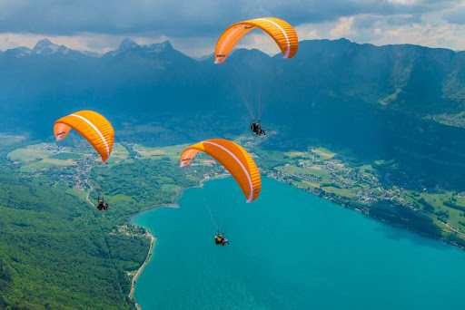
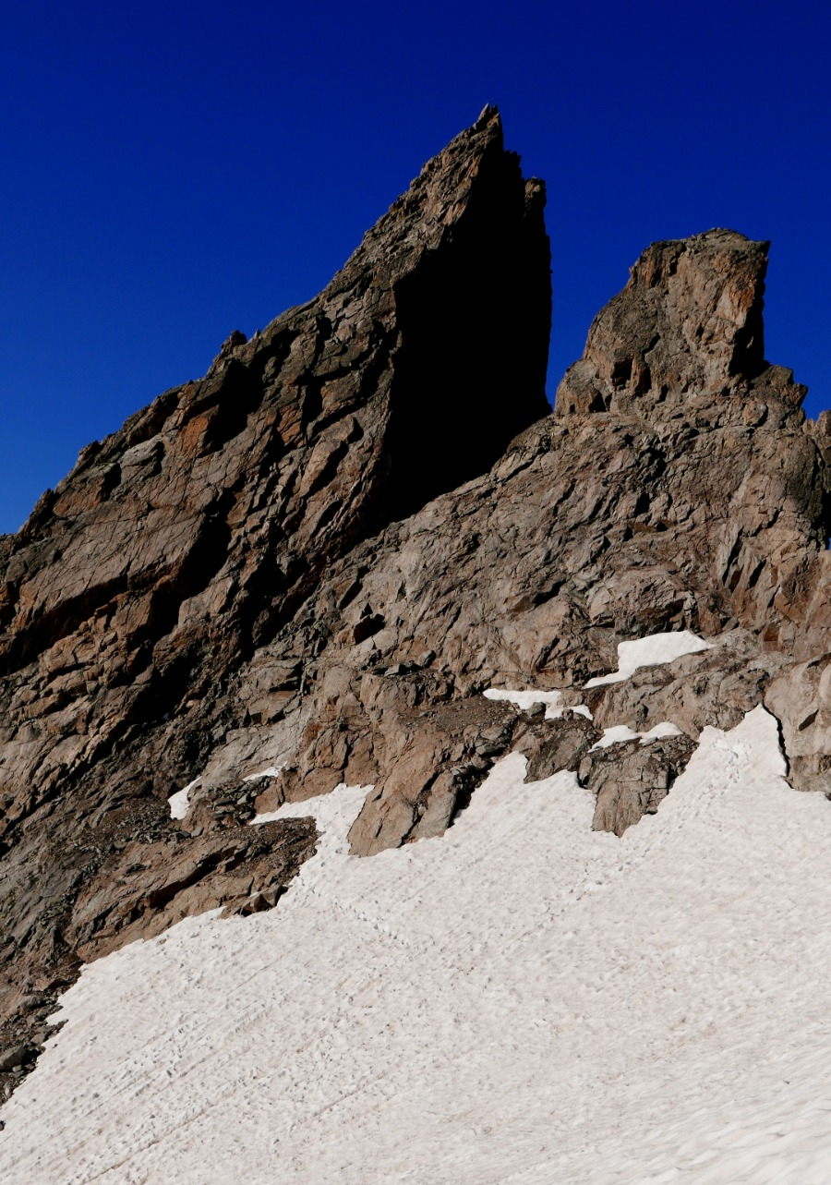
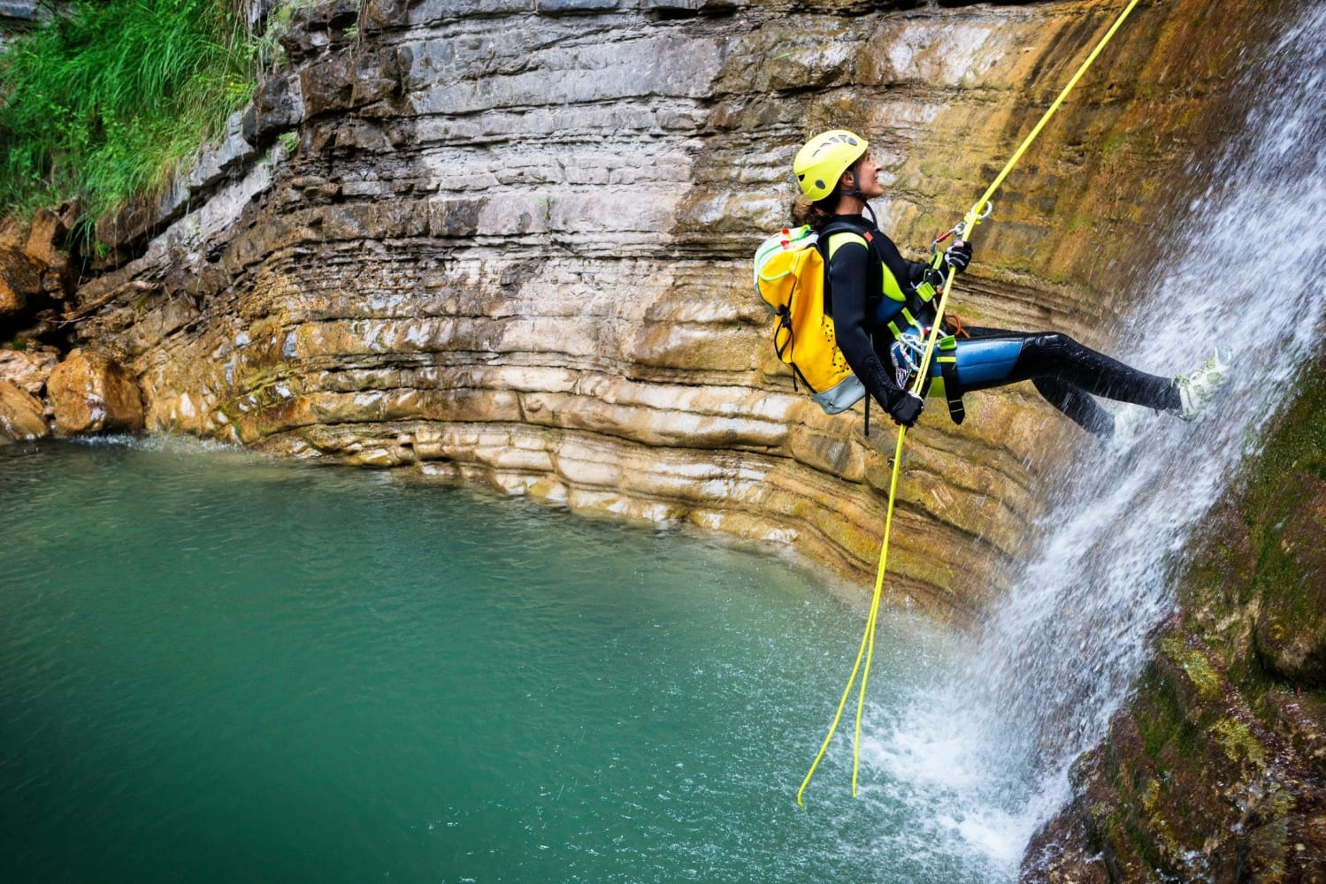
Intro
NSAC ZP commission
Alpinist courses
Canyoning
Hike to fly

Slide 4
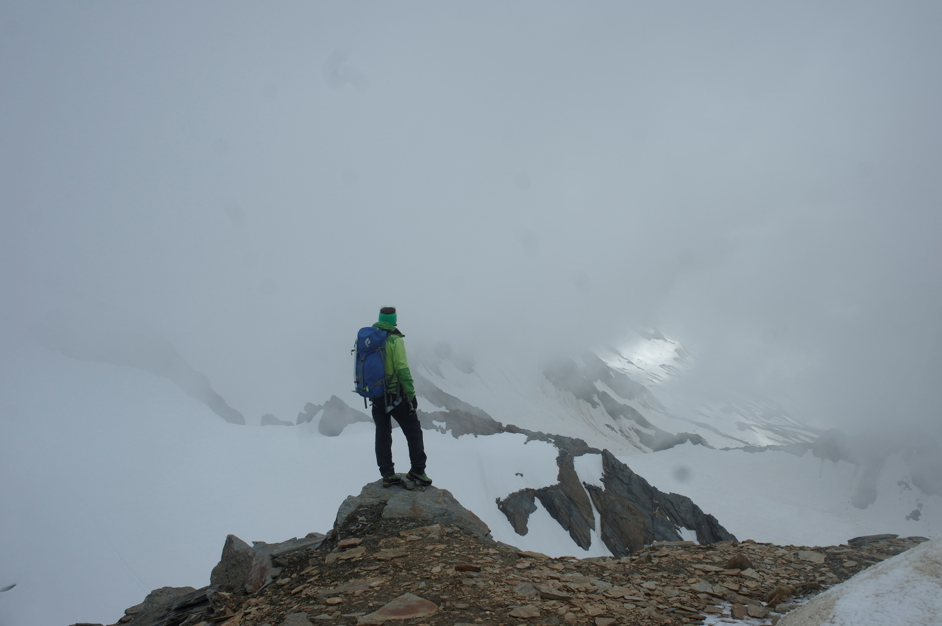
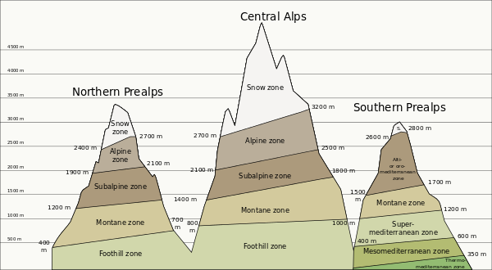
What are C courses
1 week alpinist courses, from C1 to C3
With NKBV instructors or UIAGM guides
Gateway to alpinism!
“Wellness” course

Slide 5
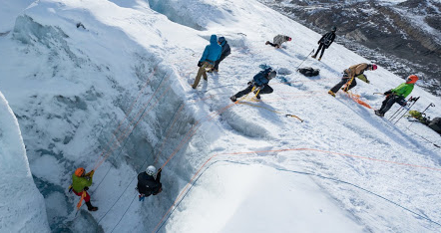
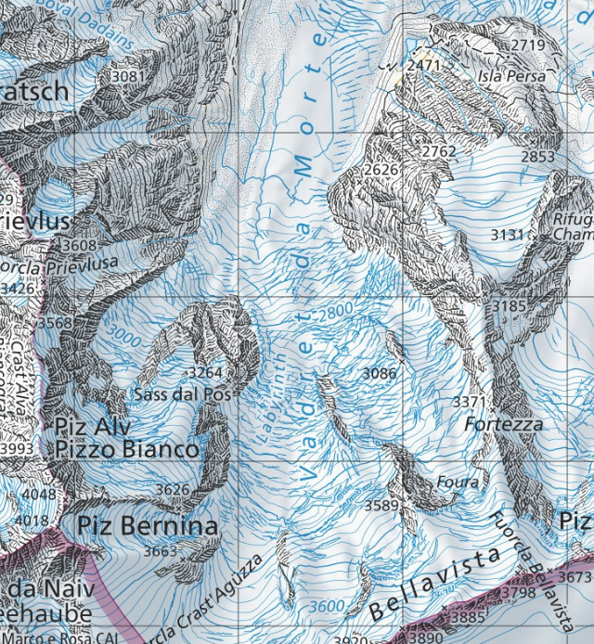
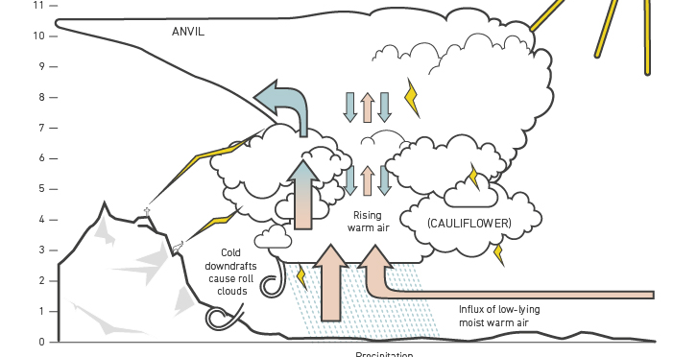
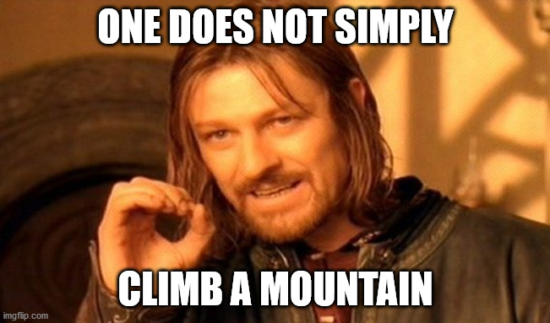
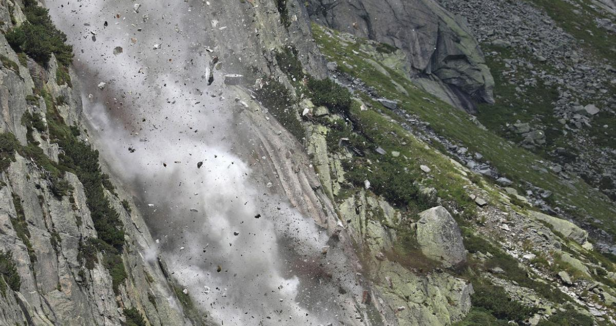
Why would you need an alpinist course?

Slide 6
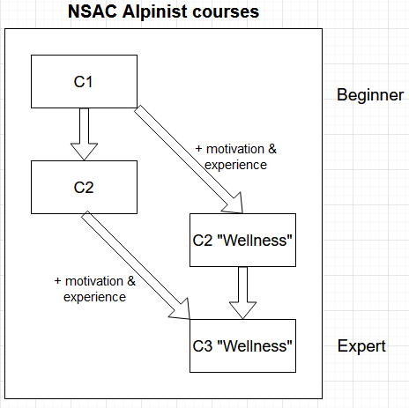
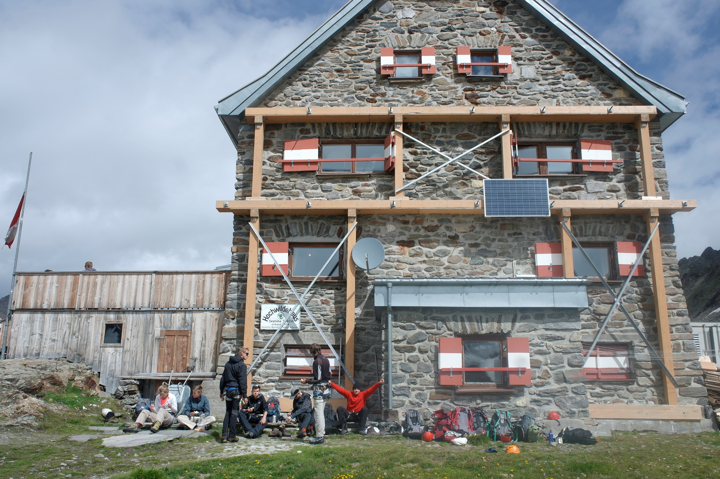
Courses for 2022

Slide 8
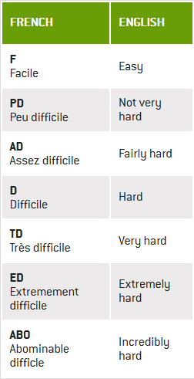
C1
Goals
Introduction to alpinism
Moving in basic rock, snow and glaciated terrain
Belaying in different types of terrain
Planning tours
Recognizing and avoiding hazards (weather, rockfall, crevasses, group dynamics)
Glacier rescuing
Do F tours independently
Have Fun!
+- 730 euro

Slide 9
C1
During the selection day running, rope skills and knots will be tested!
You should:
Be a SAC member
Be a student or younger than 25 year
Attend the selection day (2nd of April in Amsterdam!)
Be able to run 7.5 kilometers in 45 minutes
Be able to toprope at least grade 4
Be able to execute basic rope skills (rappelling, belaying with HMS)
Be able to do a seilrolle and prusiking
Know some basic climbing knots

Slide 10
Equipment (C1)
See nsac.alpenclub.nl for the full list
Climbing material
CD or D shoes (make sure they fit well! Go preferably to Zwerfkei)
Ice axe (can be borrowed from Ibex)
Crampons (can be borrowed from Ibex, make sure they fit your boots!)
1 Ice screw (can be borrowed from Ibex, at least 19cm)
Basic climbing stuff (harnass, Atc, helmet, carabiners, prusikrope, slings)
Common material
1 set of nuts + frutter
4 Bivibags (2 persons)
3 Single ropes, 50m
Clothing
Windtight hiking pants (I’ve been using this one from decathlon for 5 years already https://www.decathlon.nl/p/broek-voor-bergwandelen-trek-900/_/R-p-108842?mc=8501897&c=GROEN_KAKI
Fleece, (woolen) thermoshirt, rainpants (make sure you can put this on without undoing your shoes!!), Woolen/synthetics hiking socks, gaiters, gloves etc.
Cat 4 glasses (This one is the best value for money https://www.decathlon.nl/p/wandelzonnebril-voor-volwassenen-mh570-zwart-blauw-categorie-4/_/R-p-X864165?mc=864165&c=ZWART )
Rainproof jacket
Other
First aid kit, 40-50 liter backpack, Emergency blanket, headlight
“lakenzak”
Yes, it is expensive, but it’s the cheapest and safest way to learn proper alpinism!

Slide 11
C2 and C3
Advanced courses
Climb independently with supervision of guide
Wellness:
1 week course + 1 week independent mountaineering
Higher entry requirements (5b lead outdoor and OV-MP certificate)
No selection day but a selection weekend
See nsac.alpenclub.nl for all the information

Slide 12
Some additional tips and tricks
Be acclimatized!
Arrive preferably a week before the start (Visit the NSAC camping!)
Train in your mountaineering shoes beforehand
Be NKBV insured!
Apply before March 7th! AND pay your application fee (100 eu)
Join these Facebook groups:
NSAC: https://www.facebook.com/groups/120227867992277
Dutch Climbing Community: https://www.facebook.com/groups/1804016466591467

Slide 13
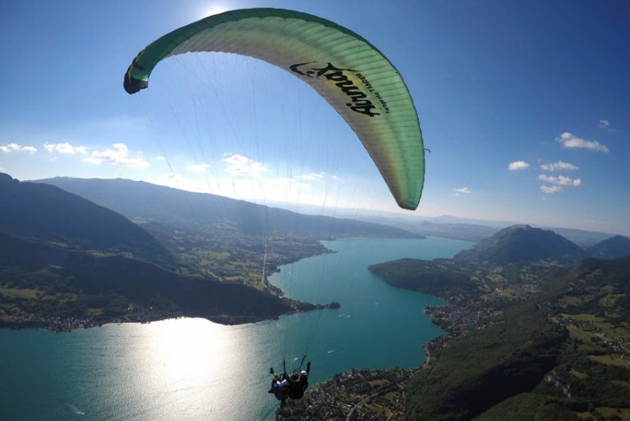
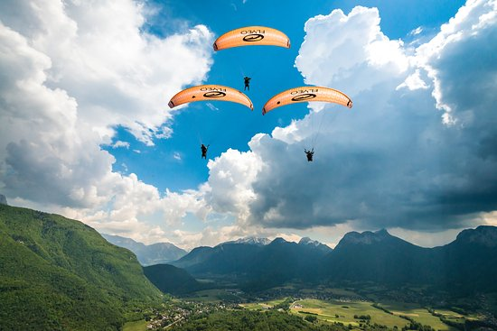
Hike to Fly
Introduction to paragliding

Slide 14
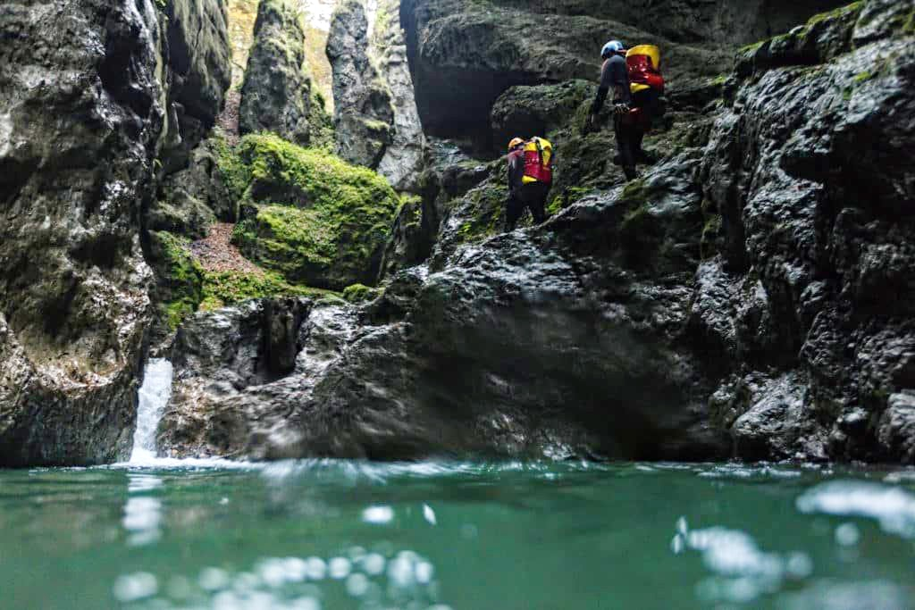
Canyoning
Introduction to Canyoning

Slide 15
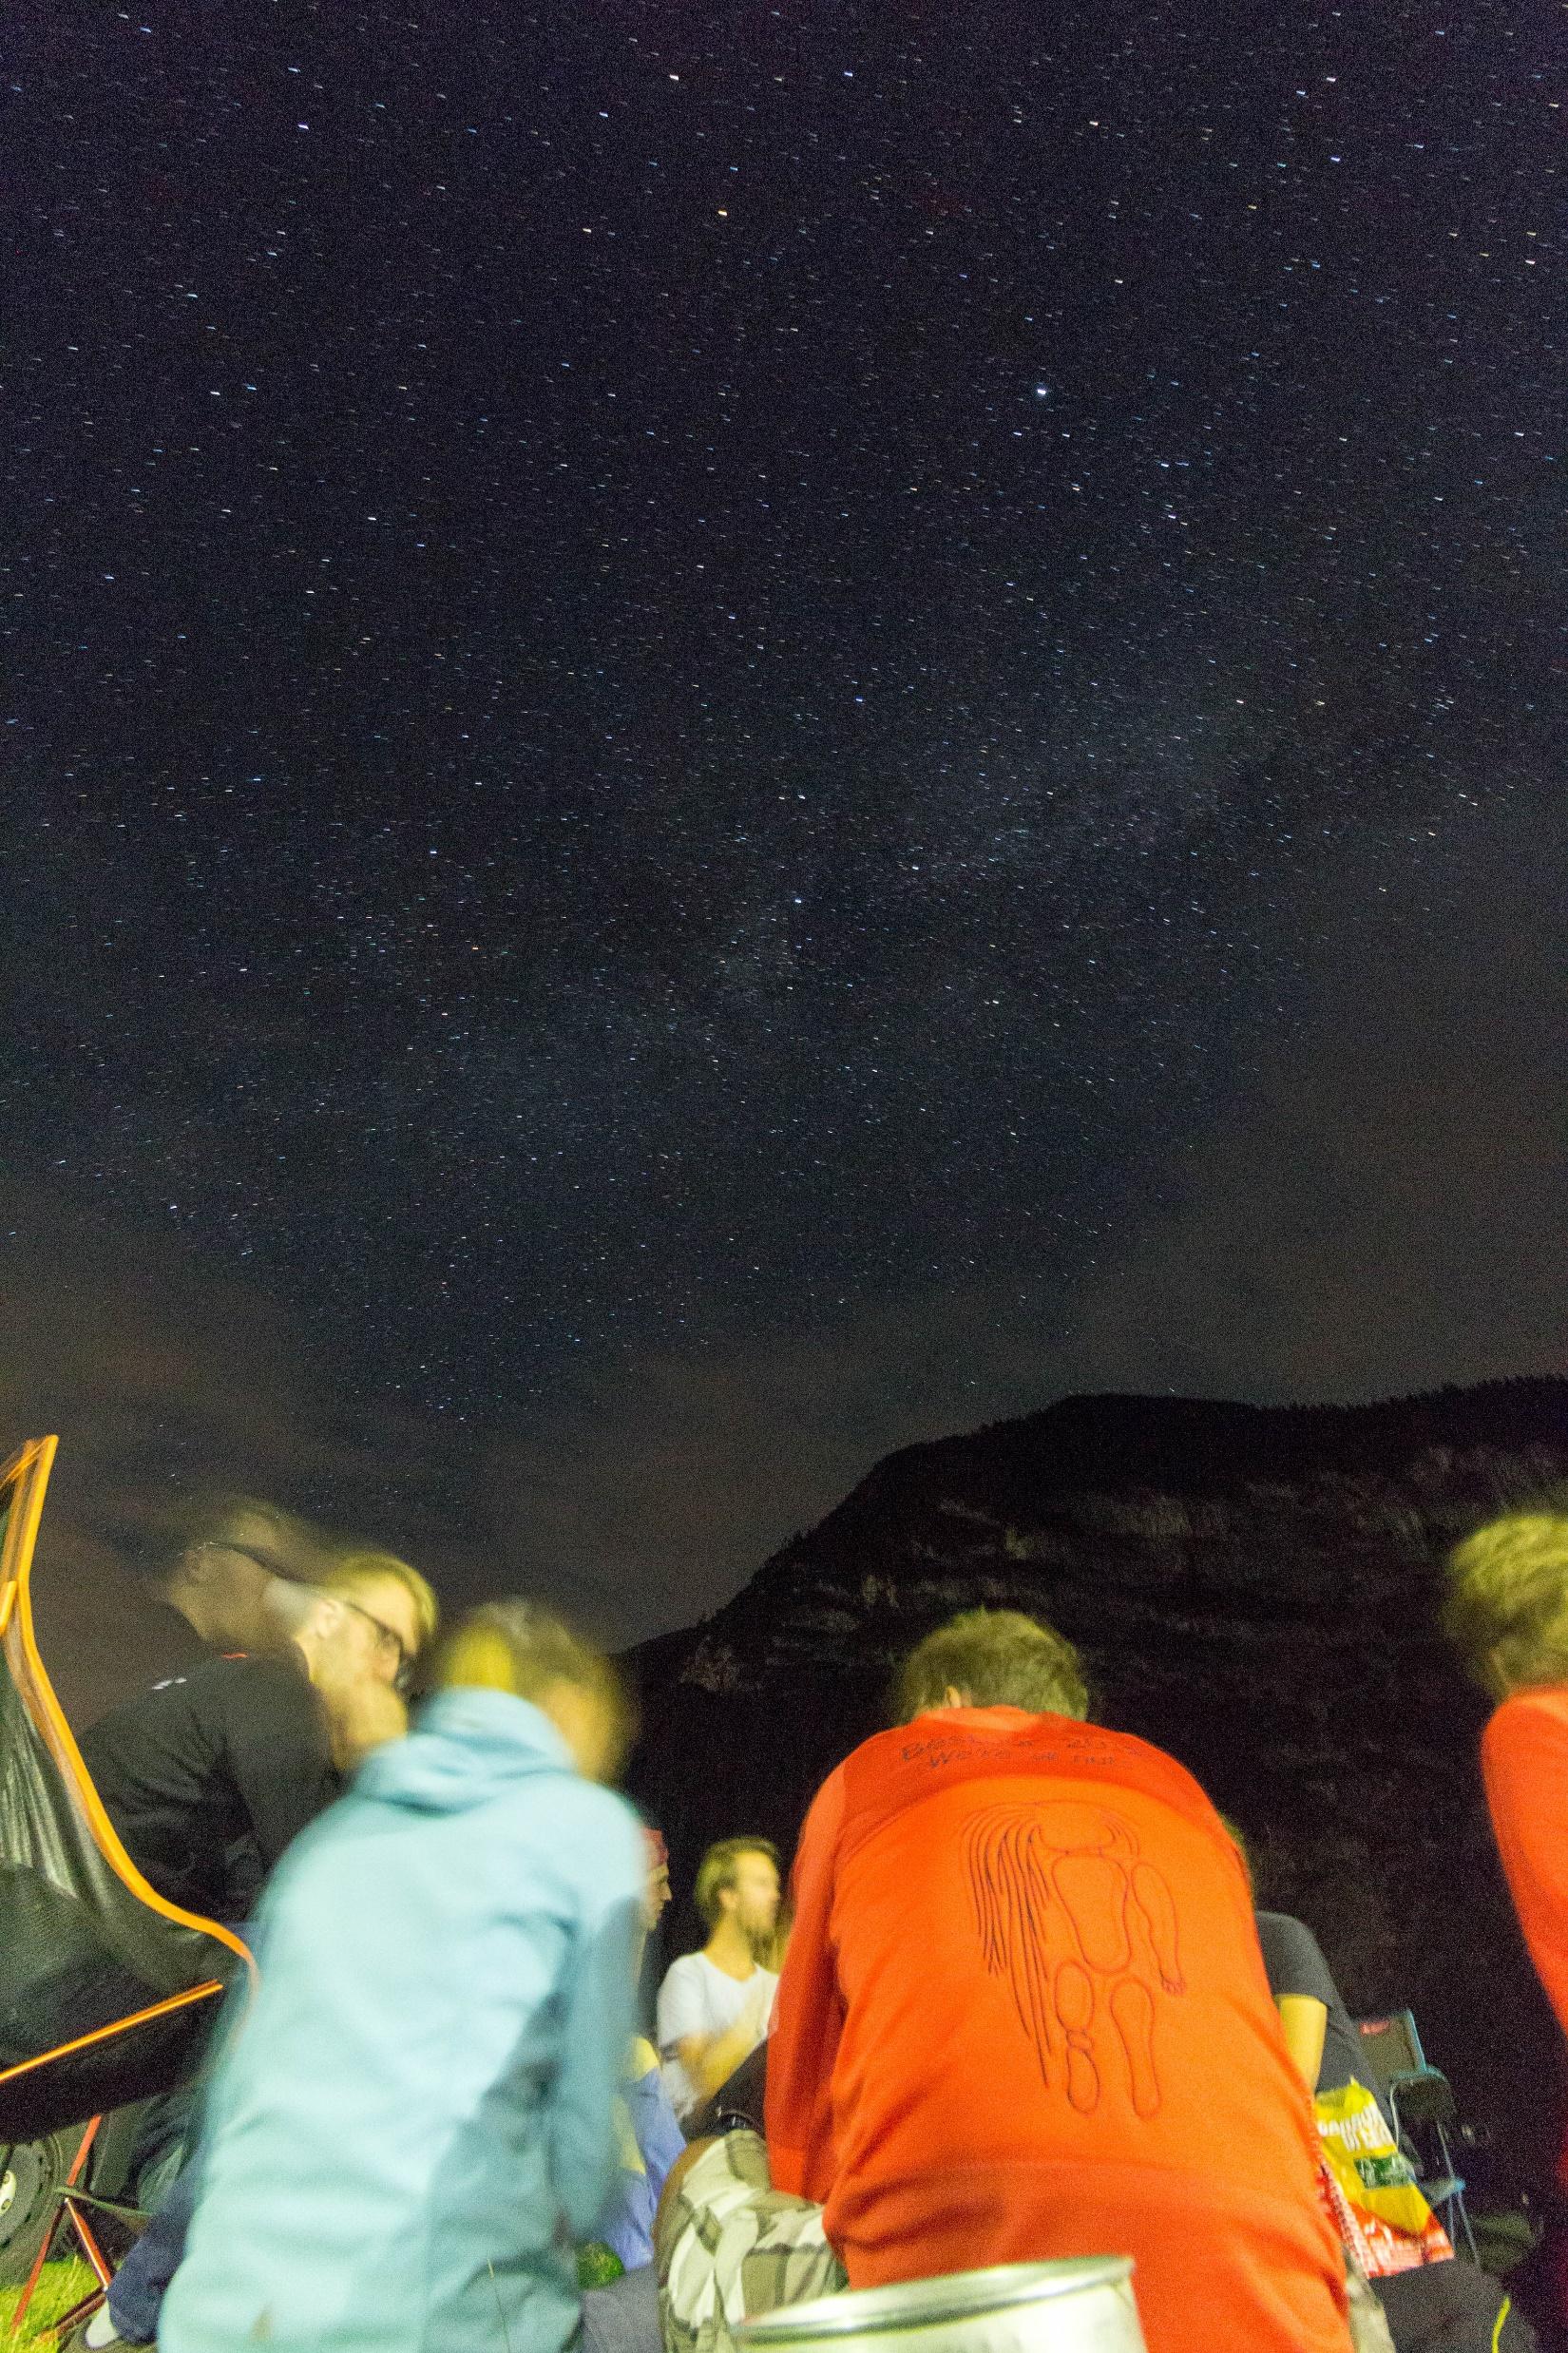
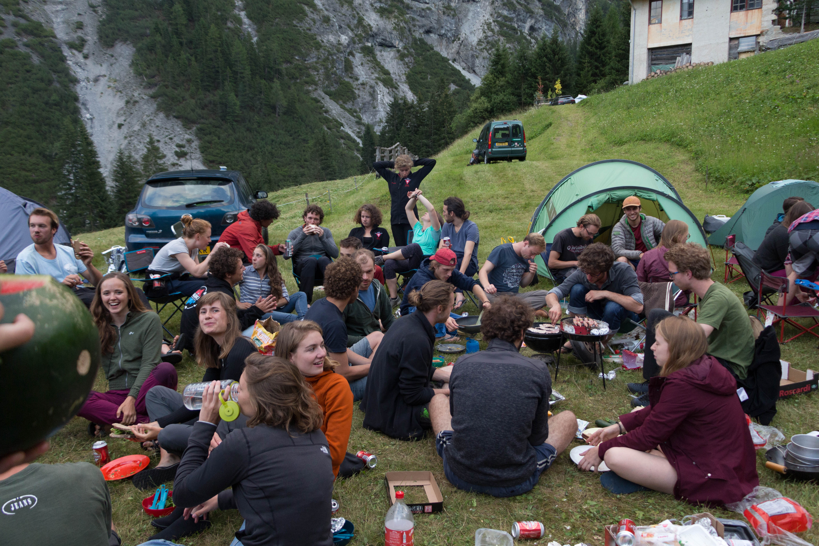
NSAC summer camping
Gathering point for Dutch student climbers in the Alps
Good place to stay to acclimatize and socialize!
No equipment and instructors!!
Location and dates are not known yet

Slide 16
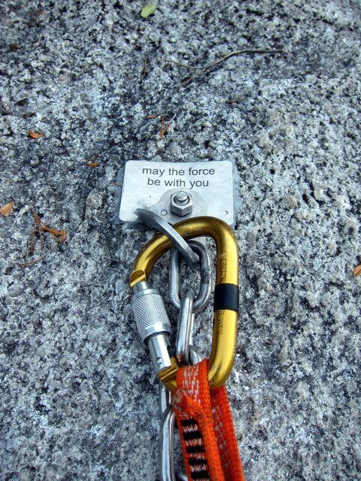
Questions
zp.nsac1@gmail.com
nsac.alpenclub.nl
Or ask me!

